Slide 1
THE CHERRY TREE
- RUSKIN BOND

Slide 2
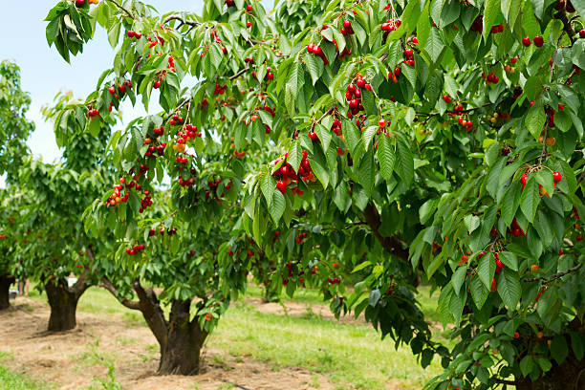

Slide 3
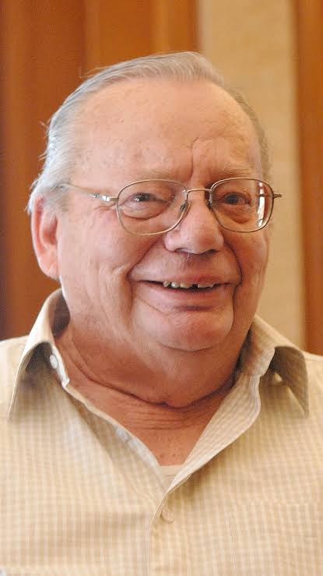
Born: 19 May 1934 (age 89 years), Kasauli
Parents: Aubrey Bond, Edith Dorothy
Awards: Sahitya Akademi Award, Padma Bhushan, John Llewellyn Rhys Prize, Padma Shri
Nationality: Indian
Siblings: Ellen Bond, William Bond
Alma mater: Bishop Cotton School

Slide 4
Ruskin Bond is an Indian author. His first novel, The Room on the Roof, was published in 1956, and it received the John Llewellyn Rhys Prize in 1957. Bond has authored more than 500 short stories, essays, and novels which includes 69 books for children.

Slide 5
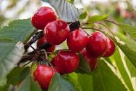
Jammu and Kashmir have a total of 2317 hectares of land under cherry cultivation. Cherry is one of the first fresh fruits to be harvested by the end of May month and ends by the conclusion of June.

Slide 6
Cherries are primarily grown in the northern regions of India, particularly in the states of Jammu and Kashmir, Himachal Pradesh, and Uttarakhand. In Jammu and Kashmir, the districts of Srinagar, Anantnag, Budgam, and Baramulla are the major producers of cherries.

Slide 7
https://www.youtube.com/watch?v=pIpgh_JZQhw

Slide 8
REFERENCES & THANKING SLIDE

